Slide 1
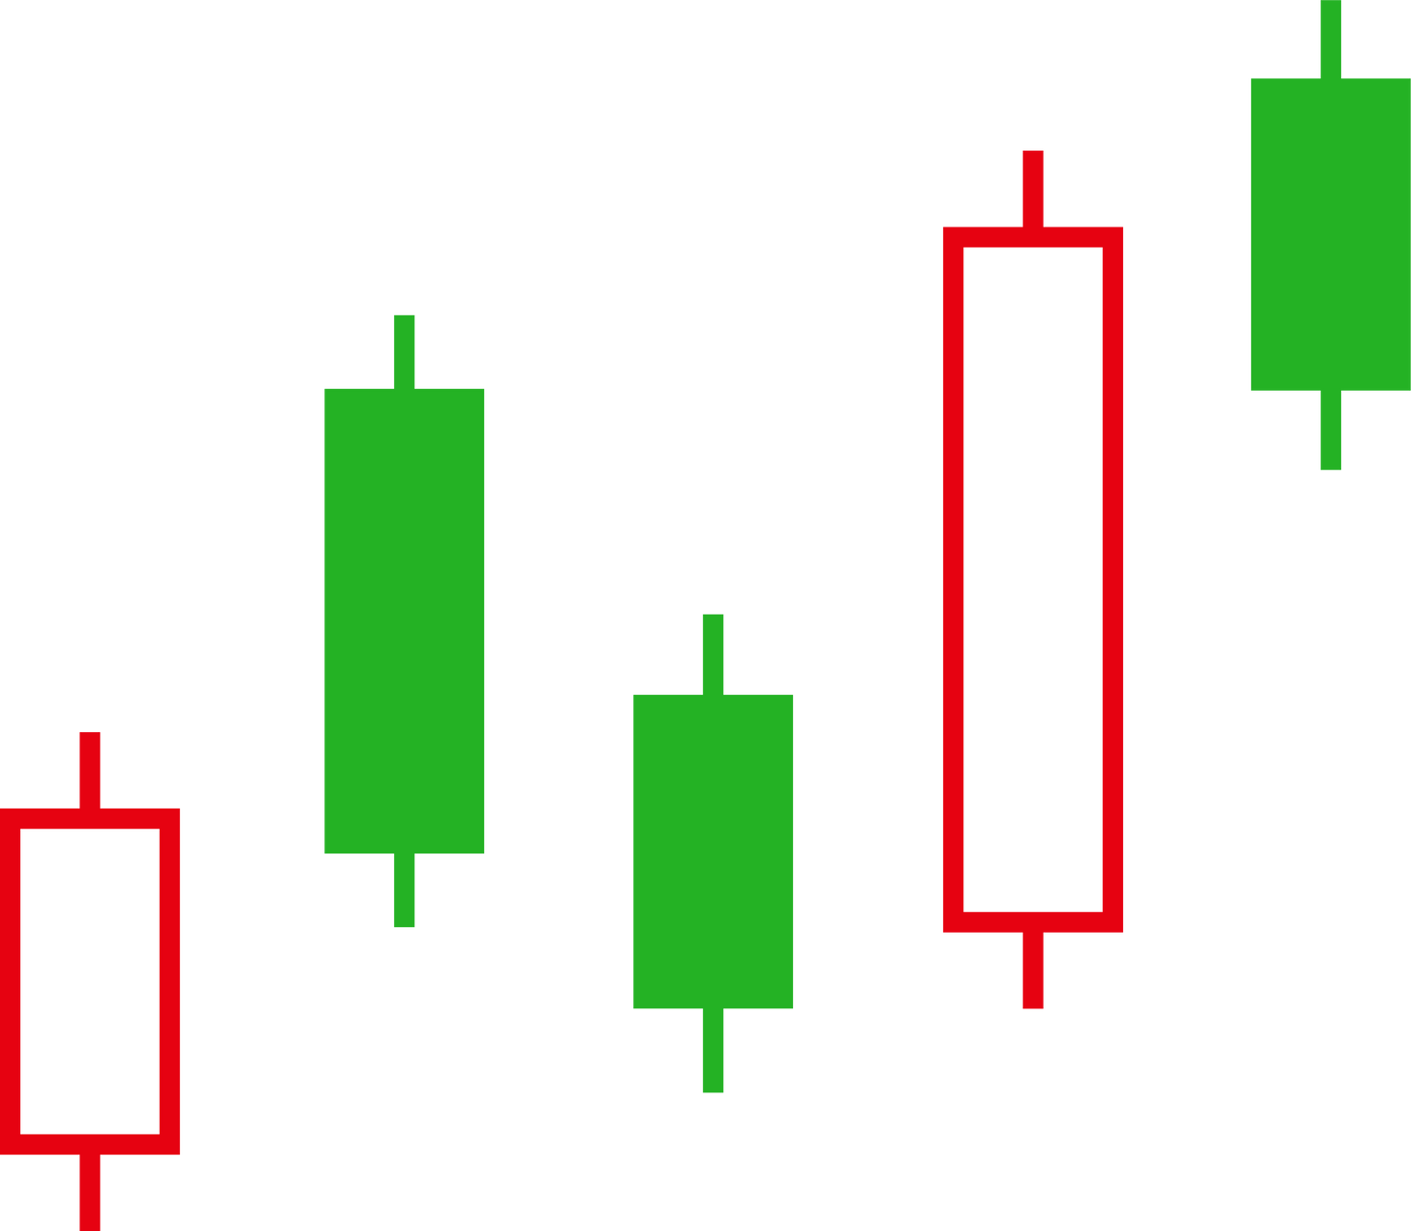




FINALGO
Algorithmic Trading Solution

Slide 2
OUR TEAM
AKSHAY KARANWAL
NAMAN AGRAWAL
ARSHIT TEOTIA
PUNEET SINGH

Slide 3
PROJECT INTRODUCTION
Development of an algorithmic trading system
Utilization of automation for trade execution
Analysis of real-time market data for identifying opportunities
Automatic execution of trades based on predefined strategies
Objectives include optimizing trading performance, managing risk, and capitalizing on market inefficiencies

Slide 4
APPROACH
Data Collection:
Fetch real-time market data from IEX cloud API.
Retrieve candlestick data and chart.
Indicator Analysis:
Use indicators such as moving averages, RSI, Bollinger Bands, and MACD to identify trading signals.
Parameter Calculation:
Calculate breakout levels, retesting conditions, and stop-loss levels.
Set stop-loss levels to mitigate risk.
Live Testing and Deployment:
Conduct live testing in simulated trading environments.
Monitor real-time performance and execution quality.

Slide 5
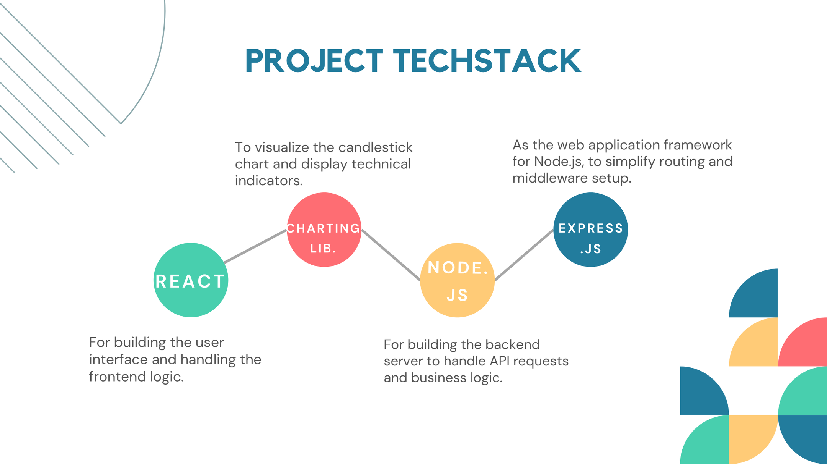

Slide 6
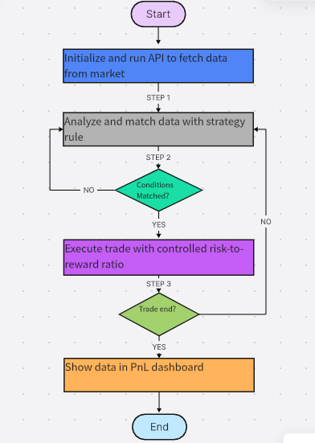
WORKING FLOWCHART

Slide 7
ADVANTAGES OVER ML SYSTEMS
• Transparency: Rules are user-defined and interpretable, allowing traders to understand the rationale behind each trade. This transparency fosters trust in the system and encourages users to engage more deeply with their trading strategies.
• Resource Efficiency: No GPU/TPU required for training models, making Finalgo a cost-effective solution for traders who may not have access to advanced computational resources. Additionally, the simplicity of the rule-based approach reduces the learning curve for new users

Slide 8
BENEFITS
Reduce Manual Work: Automates trading processes, eliminating the need for manual order placement.
Remove Emotions: Executes trades based on predefined rules, avoiding emotional decision-making.

Slide 9
Save Time: Quickly analyzes data and executes trades, enhancing trading efficiency.
Back-Test Strategies: Tests trading algorithms on historical data to validate performance.
Quicker Execution: Executes trades at optimal speeds to capitalize on market opportunities.

Slide 10
FUTURE SCOPE
1. Add support for technical indicators (e.g., Bollinger Bands) to enhance strategy options.
2. Integrate with cryptocurrency exchanges (e.g., Binance) to expand trading opportunities for
users.
3. Develop a mobile application to allow users to manage their trades on-the-go, increasing
accessibility and convenience.
4. Implement machine learning features in a future version to provide users with optional advanced analytics while maintaining the core rule-based functionality.

Slide 11
REFERENCES
1. A. Author, "Rule-Based Trading Systems," Journal of Financial Automation, 2020.
2. Alpha Vantage API Documentation, 2023. [Online]. Available: https://www.alphavantage.co
3. B. Author, "Challenges in Hybrid Trading Systems," International Journal of Financial Technology, 2021.
4. Alpaca Markets, "Trading API," 2023. [Online]. Available:
https://alpaca.markets/.
5. J. Lee and S. Kim, "Enhancing EMA Strategies with Candlestick
Filters," Proc. Int. Conf. FinTech, pp. 112–119, 2021.

Slide 12
6. D. Kahneman, Thinking, Fast and Slow. New York: Farrar, Straus and Giroux, 2011.
7. S. Nakamoto, "Blockchain-Based Decentralized Trading Systems: A
Framework for Trustless Asset Exchange," Proc. IEEE Int. Conf. Blockchain, pp. 89–94, 2020.
8. A. N. Burgess, “High-Frequency Trading and Market
Microstructure”.Cambridge:MITPress,2018.
9.T. Odean, "Behavioral Finance: Lessons for Algorithmic Trading,"
Annual Review of Financial Economics, vol. 14, pp. 213–240, 2022.

Slide 13
THANK YOU

